Slide 1

Visual Analysis Of Network Security Datasets
Team Members
Sai Sreeja Singireddy (2201637)
Sai Sri Charishma Vaddi (2157099)
Notes:
Good afternoon everyone, I am sai sreeja and here is my teammate charishma and we are here to present the project that we have worked on entitled visual analysis of network security dataset

Slide 2


Content
Problem Definition
Introduction
Methodology
Visualization Techniques and Results
Future Scope and Conclusion
Teammates Contribution
Notes:
These are the contents that we are going to cover in today’s presentation

Slide 3

Problem Definition
This presentation provides a visual analysis of the two computer network security or intrusion detection datasets(UNSW-NB15 and KDD Cup 1999), highlighting potential issues and preprocessing techniques.The network security datasets are a valuable resource for developing intrusion detection systems, yet its intricate nature poses challenges that may impact the efficiency of data-driven models.Consequent analysis through visualization identified and illustrated two major visualization problems as class imbalance and class overlap for these datasets.
Notes:
In our project we are trying to do the visual analysis of two computer network security or intrusion detection datasets to identify any issues that are present before we can make use of this dataset in any data-driven machine learning classifier models.For this visualizing is a good and essential approach.By leveraging visualization, we explore and interpret patterns, anomalies, and potential issues that might hinder classifier model effectiveness.

Slide 4

Introduction
Visualization is a pivotal tool in data analysis, particularly when preparing datasets for the development of data-driven classifier models, such as those used in intrusion detection. Our study focuses on a visual analysis of the UNSW-NB15 dataset and KDD Cup 1999 dataset, which, despite their frequent use in cybersecurity research, still presents challenges that can adversely affect the performance of classifiers, notably class imbalance and overlap.
Notes:
So to effectively identify the issues visualizing is a good and essential approach.By leveraging visualization, we can explore and interpret patterns, anomalies, and potential issues that might hinder classifier model effectiveness.

Slide 5
Methodology
Preprocessing the Dataset
Elimination of redundant features
Conversion of nominal features
Data Scaling
Feature Selection using RandomForestClassifier
1
Perform Visualizations
Mahalanobis Distance
PCA and t-SNE
K-means
UMAP
Parallel Coordinates
2
Issue Identification and Dashboard Visualization
Class Overlap
Class Imbalance
3
Notes:
These are the steps that we have followed.
The first and important step included preprocessing that is we have removed redundant features,Converted categorical features to numerical format and input data scaling.
Then we have used four vis techniques to vis the data which are and created an interactive dashboard which made it very easy to identify the issues class imbalance and overlap

Slide 6
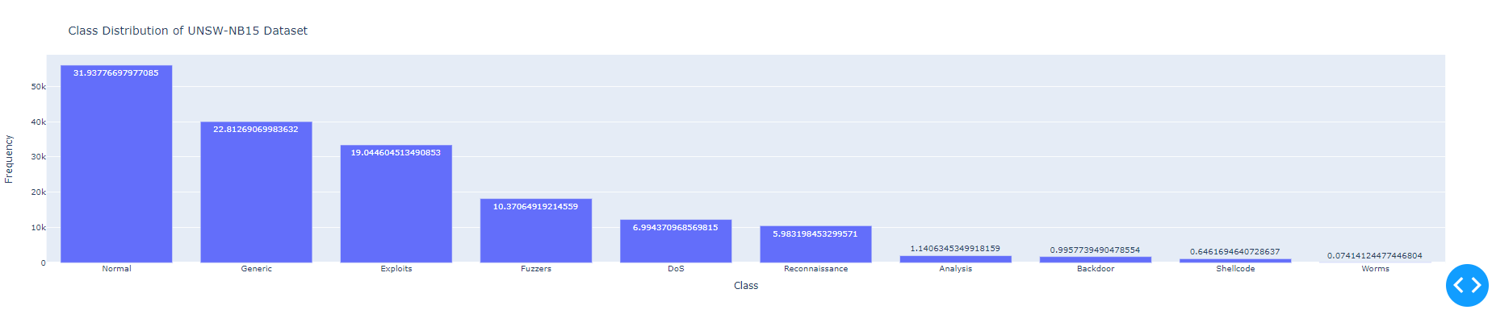
Dataset 1 UNSW-NB15
Attacks are categorized into Analysis, Backdoor, DoS, Exploits, Fuzzers, Generic, Reconnaissance, Shellcode, and Worms.
Notes:
UNSW-NB15 data was released in the year 2015 and is comprised of 25,40,044 realistic normal and attack network activities with a total of 49 features

Slide 7
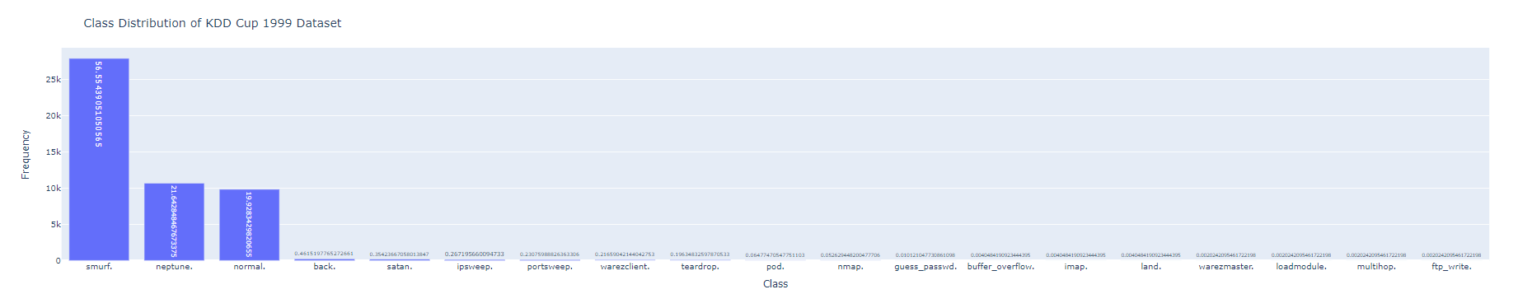
Dataset 2 KDD Cup
The Dataset contain a total number of 23 training attack types. Some of them are normal, buffer_overflow, loadmodule,perl etc
Notes:
The KDD Cup 1999 dataset, released as part of the Knowledge Discovery and Data Mining (KDD) Cup in 1999, is a widely used benchmark dataset for intrusion detection containing a total of 41 features.

Slide 8
Visualization - Mahalanobis Distance
Mahalanobis distance is used to measure the distance between class centroids.It serves as a crucial metric for identifying similarities and dissimilarities between classes
Lower the score, higher the similarity and vice versa
Key Findings:
Similar Classes - Overlap exists
Dissimilar Classes - No Overlap
Notes:
As a part of the preprocessing in order to map the input features to same scale we use different 6 diff data transformation algorithms,we then measure nearest shrunken centroid, a classification method used for feature selection and classification for attack classes and normal class and calculate the distance between the class centroids using mahalanobis distance before and after applying scalers.NSC improves the performance by reducing the impact of less discriminative features
Despite advancements, some class overlap persists, highlighting the need for additional strategies.

Slide 9
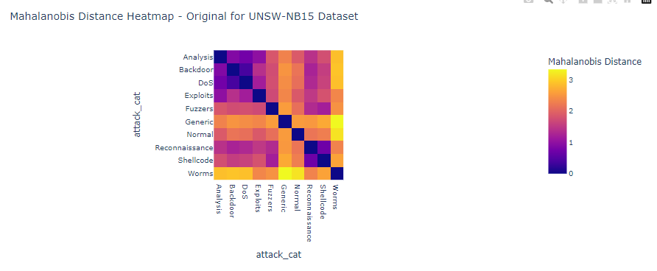
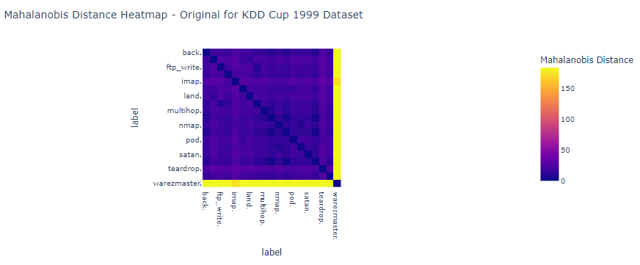
Visualization - Mahalanobis Distance
For UNSW-NB15 Dataset - Most Similar: worms.' and analysis.'
Most Dissimilar: DoS.' and Backdoor.
After Scaling - Most Similar: worms.' and analysis.'
Most Dissimilar: DoS.' and Backdoor.
For KDD Cup Dataset - Most Similar: 'smurf.' and 'neptune.'
Most Dissimilar: 'warezmaster.' and 'perl.'
After Scaling - Most Similar: 'smurf.' and 'neptune.'
Most Dissimilar: 'perl.' and 'land.'
We can observe that the dissimilarity has increased after scaling and the dataset still has the class overlap although to a lesser degree.
Notes:
As a part of the preprocessing in order to map the input features to same scale we use different 6 diff data transformation algorithms,we then measure nearest shrunken centroid, a classification method used for feature selection and classification for attack classes and normal class and calculate the distance between the class centroids using mahalanobis distance before and after applying scalers.NSC improves the performance by reducing the impact of less discriminative features
Despite advancements, some class overlap persists, highlighting the need for additional strategies.

Slide 10
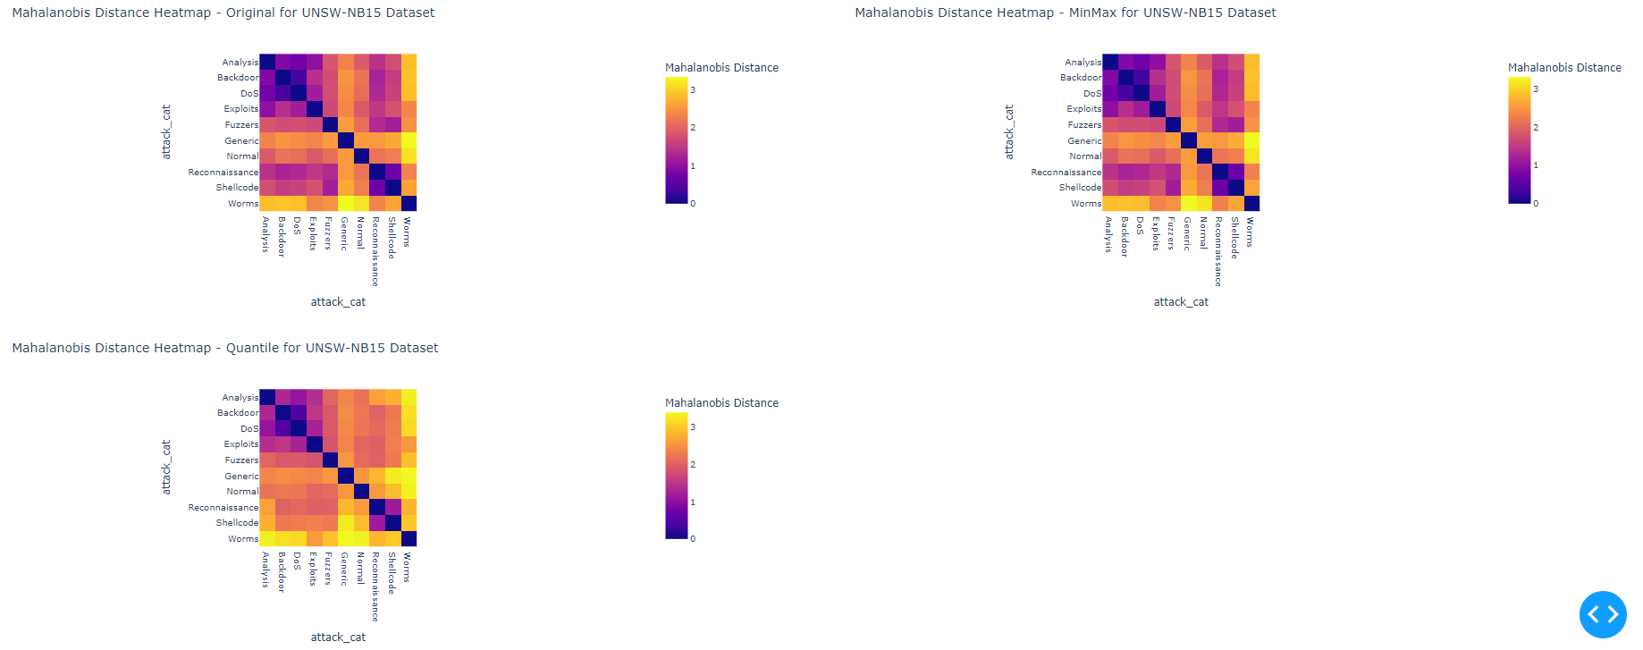
Visualization - Mahalanobis Distance
After Implementing 2 Data Transformation Algorithms UNSW-NB15 Dataset
Notes:
As a part of the preprocessing in order to map the input features to same scale we use different 6 diff data transformation algorithms,we then measure nearest shrunken centroid, a classification method used for feature selection and classification for attack classes and normal class and calculate the distance between the class centroids using mahalanobis distance before and after applying scalers.NSC improves the performance by reducing the impact of less discriminative features
Despite advancements, some class overlap persists, highlighting the need for additional strategies.

Slide 11
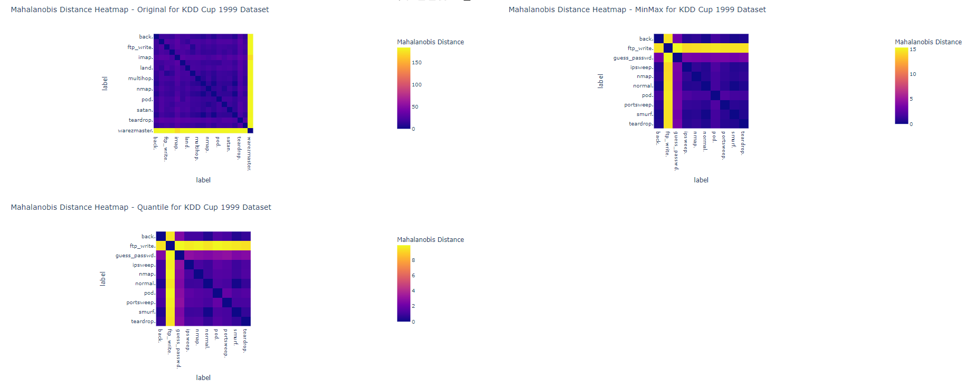
Visualization - Mahalanobis Distance
After Implementing 2 Data Transformation Algorithms KDD 1999 Cup Dataset
Notes:
As a part of the preprocessing in order to map the input features to same scale we use different 6 diff data transformation algorithms,we then measure nearest shrunken centroid, a classification method used for feature selection and classification for attack classes and normal class and calculate the distance between the class centroids using mahalanobis distance before and after applying scalers.NSC improves the performance by reducing the impact of less discriminative features
Despite advancements, some class overlap persists, highlighting the need for additional strategies.

Slide 12
Visualization - PCA
PCA (Principal Component Analysis) is used to reduce the dimensionality of high-dimensional cybersecurity datasets.
The primary goal is to reduce complexity while preserving essential variance.
This simplification process is critical for transforming complex data into a more interpretable format.
Importantly, it maintains the integrity of the original information content within the data.
Notes:
To discover whether the classes are made up of imbalanced sub-clusters, we use two visualizing techniques from scikit-learn machine learning library in Python, namely PCA and t-SNE.

Slide 13
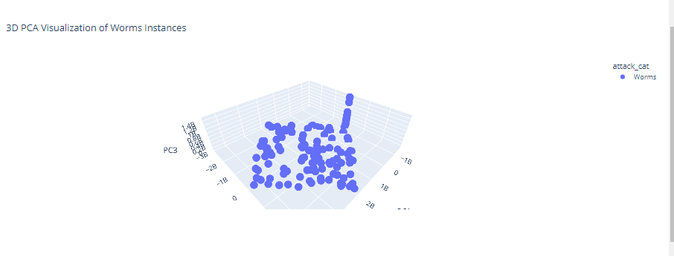
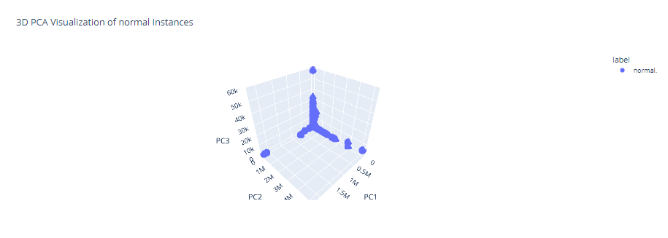
Visualization - PCA
PCA for Individual Classes
Visualization of the Worms class(UNSW-NB15)instances using PCA.Through clusters we can infer that there is a lot of imbalance and variance among classes
Visualization of the normal class(KDD Cup) instances using PCA.Through clusters we can infer that there is a lot of imbalance and variance among classes
Notes:
To discover whether the classes are made up of imbalanced sub-clusters, we use two visualizing techniques from scikit-learn machine learning library in Python, namely PCA and t-SNE.

Slide 14
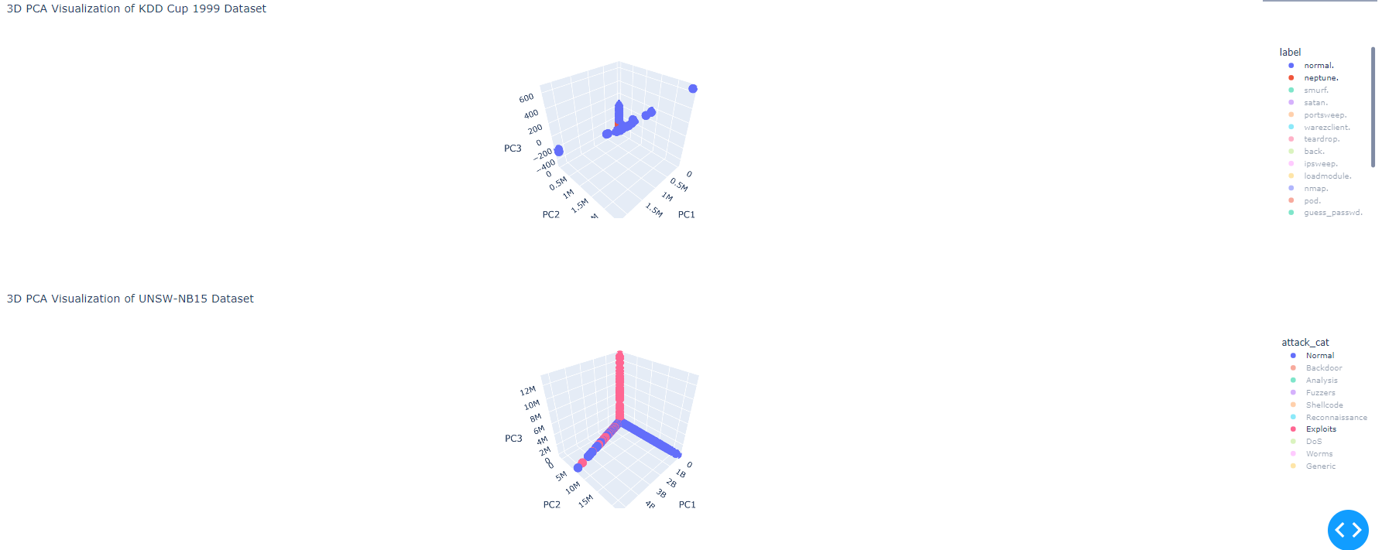
Visualization - PCA
PCA for a pair of classes
In the above image, a 3-dimensional scatter plot reveals a significant "overlap problem" between the two classes
Notes:
To discover whether the classes are made up of imbalanced sub-clusters, we use two visualizing techniques from scikit-learn machine learning library in Python, namely PCA and t-SNE.

Slide 15
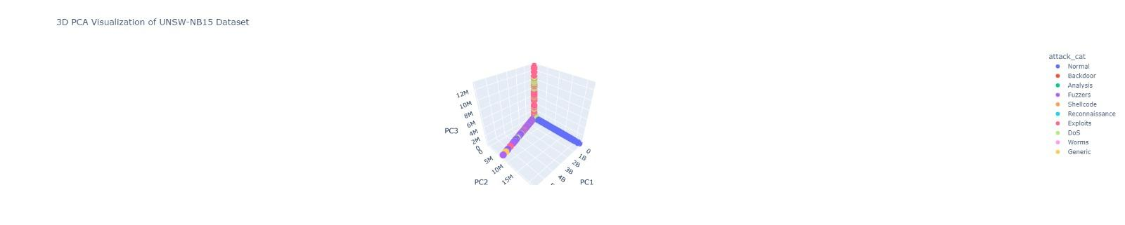
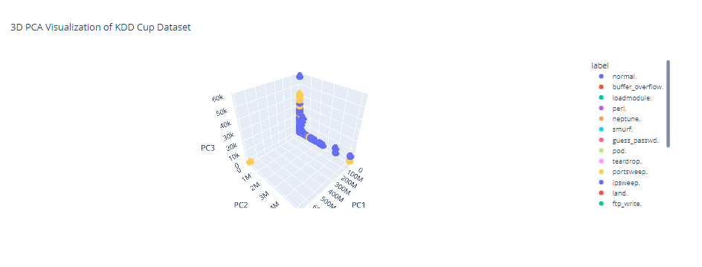
Visualization - PCA
Visualization of the entire dataset using PCA for class overlap
In the above image, a 3-dimensional scatter plot reveals a significant "overlap problem" in the dataset. Many attack class records closely mimic the behavior of Normal records, resulting in overlapping regions highlighted by dotted circles. This issue poses a challenge for intrusion detection systems, emphasizing the importance of addressing the overlap problem during training to achieve satisfactory outcomes.
Notes:
To discover whether the classes are made up of imbalanced sub-clusters, we use two visualizing techniques from scikit-learn machine learning library in Python, namely PCA and t-SNE.

Slide 16
Visualization - t-SNE
t-SNE effectively maps high-dimensional data into a lower-dimensional space.
It uncovers clusters and patterns within the data.
This visualization technique is adept at revealing nuanced groupings within the datasets.
It enhances the pattern recognition capabilities of the analysis.
Notes:
The 2-dimensional scatter plot reveals that class types exhibit multiple clusters of varying sizes, suggesting diverse patterns within each class.,Clusters are spread across the analysis space, indicating a complex distribution of data points.

Slide 17
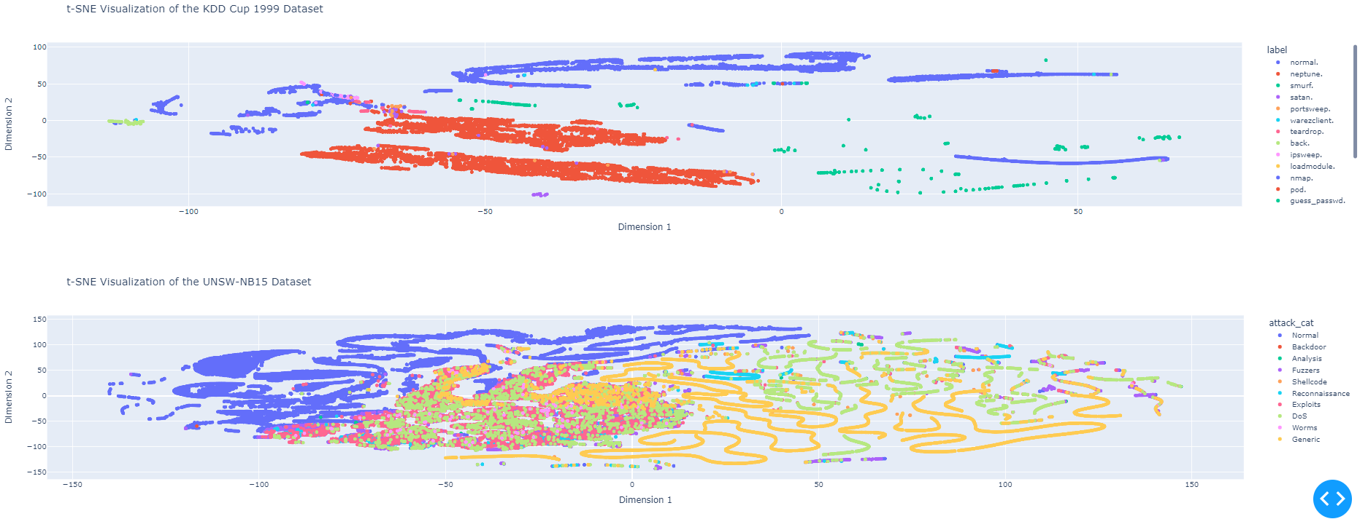
Visualization - t-SNE
Key Findings:
Classes are not distinctly separated but have multiple clusters of varying sizes
Significant overlap between clusters of different classes
Notable "overlap problem" where attack classes mimic normal behavior
Notes:
The 2-dimensional scatter plot reveals that class types exhibit multiple clusters of varying sizes, suggesting diverse patterns within each class.,Clusters are spread across the analysis space, indicating a complex distribution of data points.

Slide 18
Visualization - K-means
K-means clustering method is used to compute the distance between the class centroids and represents the "centers" of these groups, enabling the visualization of inter-cluster distances to illustrate the degree of overlap between different classes in a 2D map.
Key Findings:
The closer the circles drawn, the closer the data points are in the original feature space.
The clusters are sized according to the number of the members in a single cluster.
Notes:
As a part of the preprocessing in order to map the input features to same scale we use different 6 diff data transformation algorithms,we then measure nearest shrunken centroid, a classification method used for feature selection and classification for attack classes and normal class and calculate the distance between the class centroids using mahalanobis distance before and after applying scalers.NSC improves the performance by reducing the impact of less discriminative features
Despite advancements, some class overlap persists, highlighting the need for additional strategies.

Slide 19
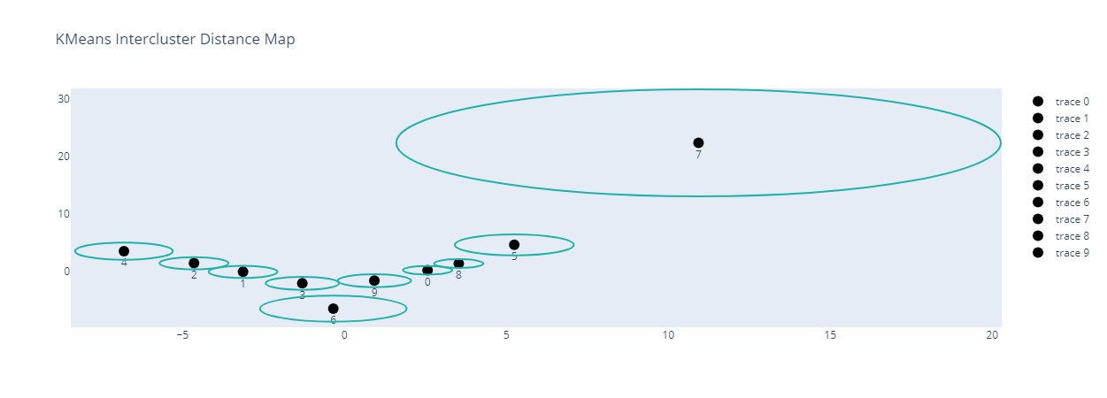
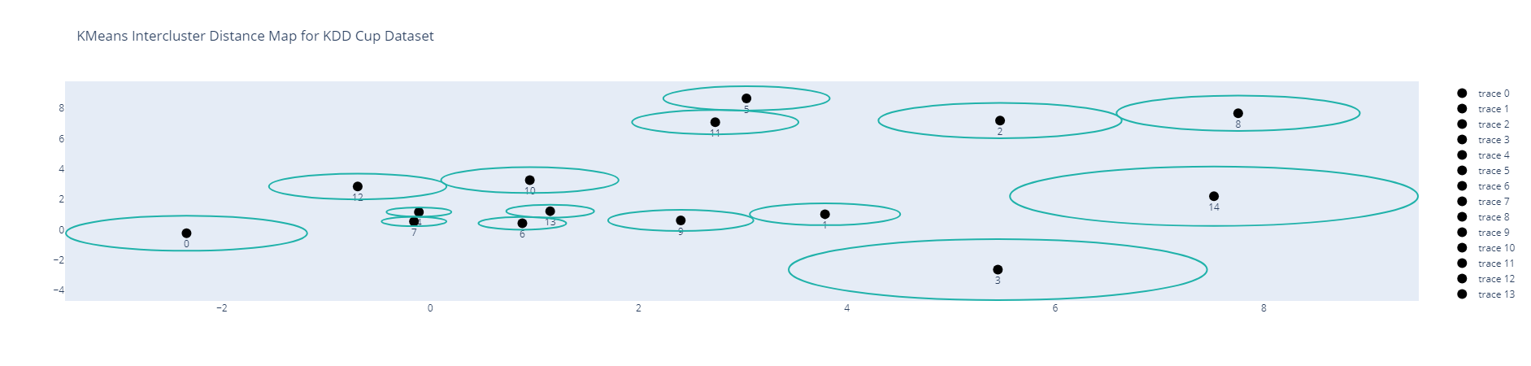
Visualization - K-means
We can observe that clusters 1,2 and 3,9 and 0,8 overlap in UNSW-NB15 Dataset
We can observe more overlap in this dataset that is among clusters 4,7 and 6,13 and 12,10 and so on.
The map gives a sense of the number of data points in a cluster, how they spread all across the cluster, and the probability of class overlap.
Notes:
As a part of the preprocessing in order to map the input features to same scale we use different 6 diff data transformation algorithms,we then measure nearest shrunken centroid, a classification method used for feature selection and classification for attack classes and normal class and calculate the distance between the class centroids using mahalanobis distance before and after applying scalers.NSC improves the performance by reducing the impact of less discriminative features
Despite advancements, some class overlap persists, highlighting the need for additional strategies.

Slide 20
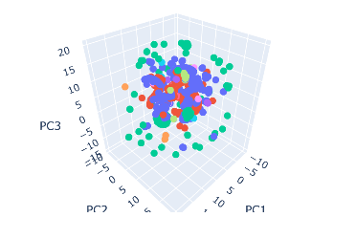
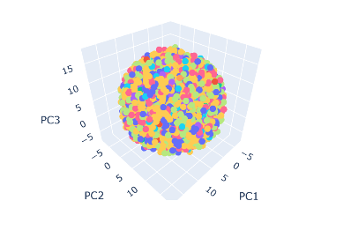
Visualization - UMAP
Similar to t-SNE, UMAP provides dimensionality reduction but with faster computation and often more meaningful representations, particularly in capturing the global structure of data.
UMAP visualizations of the KDD Cup(left image) and UNSW-NB15(right image) datasets illustrate class distribution and interaction, indicating imbalances with densely populated clusters for some classes and sparse ones for others. Overlapping clusters signal class inseparability in feature space, posing classification challenges and potential misclassification risks.
Notes:
As a part of the preprocessing in order to map the input features to same scale we use different 6 diff data transformation algorithms,we then measure nearest shrunken centroid, a classification method used for feature selection and classification for attack classes and normal class and calculate the distance between the class centroids using mahalanobis distance before and after applying scalers.NSC improves the performance by reducing the impact of less discriminative features
Despite advancements, some class overlap persists, highlighting the need for additional strategies.

Slide 21
Visualization - Parallel Coordinates
Multi-dimensional visualization techniques are pivotal for inspecting all features and their relationships simultaneously.
The parallel coordinates plot is valuable for comprehending intricate relationships between attributes.
It helps pinpoint outliers and trends across the datasets in the project.
Notes:
As a part of the preprocessing in order to map the input features to same scale we use different 6 diff data transformation algorithms,we then measure nearest shrunken centroid, a classification method used for feature selection and classification for attack classes and normal class and calculate the distance between the class centroids using mahalanobis distance before and after applying scalers.NSC improves the performance by reducing the impact of less discriminative features
Despite advancements, some class overlap persists, highlighting the need for additional strategies.

Slide 22
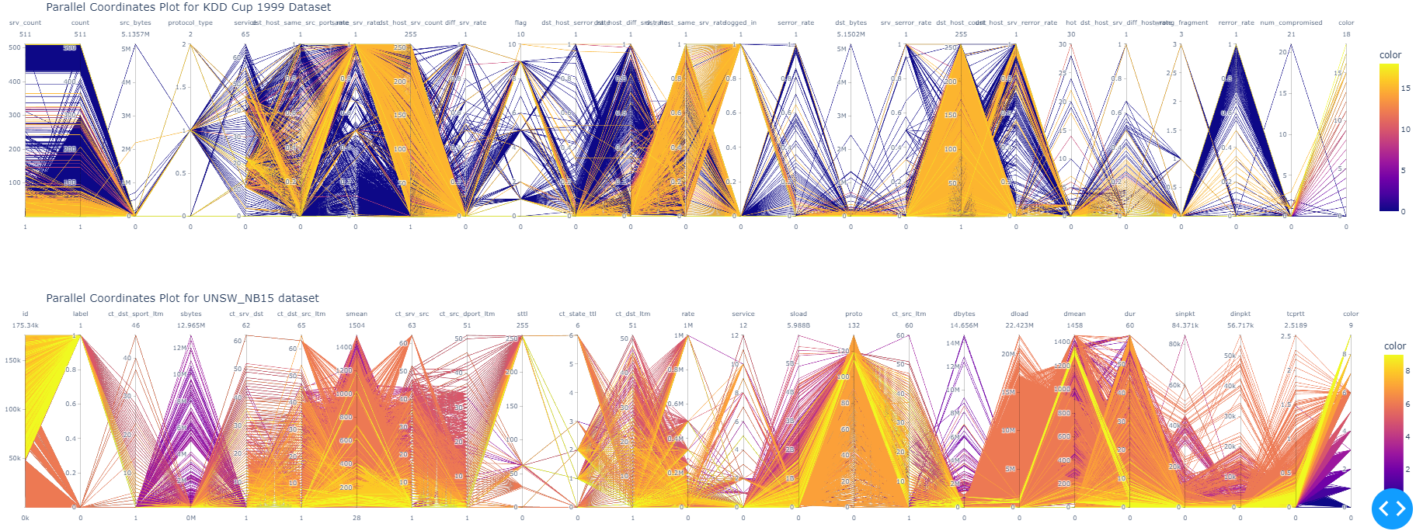
Visualization - Parallel Coordinates
Key Findings:
Reveal complex interactions between features across classes
Dense overlaps indicating potential class confusion
Sparse areas suggesting unique class traits.
Notes:
As a part of the preprocessing in order to map the input features to same scale we use different 6 diff data transformation algorithms,we then measure nearest shrunken centroid, a classification method used for feature selection and classification for attack classes and normal class and calculate the distance between the class centroids using mahalanobis distance before and after applying scalers.NSC improves the performance by reducing the impact of less discriminative features
Despite advancements, some class overlap persists, highlighting the need for additional strategies.

Slide 23
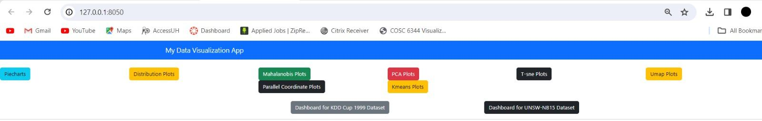
Visualization Dashboard - Home Page
Dash is running on http://127.0.0.1:8050/
* Serving Flask app 'viz testing'
* Debug mode: on
After Clicking the link given a page is displayed in this manner.
Notes:
As a part of the preprocessing in order to map the input features to same scale we use different 6 diff data transformation algorithms,we then measure nearest shrunken centroid, a classification method used for feature selection and classification for attack classes and normal class and calculate the distance between the class centroids using mahalanobis distance before and after applying scalers.NSC improves the performance by reducing the impact of less discriminative features
Despite advancements, some class overlap persists, highlighting the need for additional strategies.

Slide 24
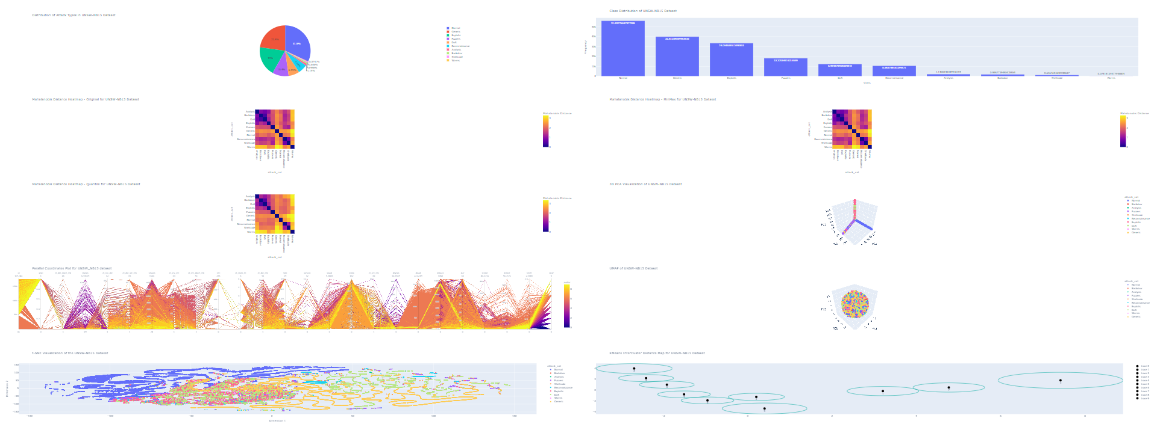
Visualization Dashboard
After clicking on the UNSW-NB15 Dataset Dashboard button this is the interactive dashboard that is displayed
Notes:
As a part of the preprocessing in order to map the input features to same scale we use different 6 diff data transformation algorithms,we then measure nearest shrunken centroid, a classification method used for feature selection and classification for attack classes and normal class and calculate the distance between the class centroids using mahalanobis distance before and after applying scalers.NSC improves the performance by reducing the impact of less discriminative features
Despite advancements, some class overlap persists, highlighting the need for additional strategies.

Slide 25
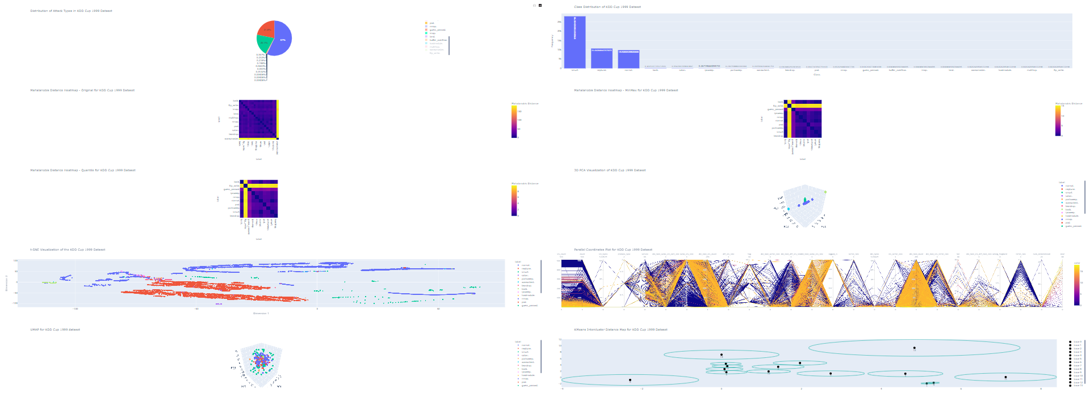
Visualization Dashboard
After clicking on the KDD-Cup Dataset Dashboard button this is the interactive dashboard that is displayed
Notes:
As a part of the preprocessing in order to map the input features to same scale we use different 6 diff data transformation algorithms,we then measure nearest shrunken centroid, a classification method used for feature selection and classification for attack classes and normal class and calculate the distance between the class centroids using mahalanobis distance before and after applying scalers.NSC improves the performance by reducing the impact of less discriminative features
Despite advancements, some class overlap persists, highlighting the need for additional strategies.

Slide 26
Conclusion
Both KDD Cup 1999 and UNSW-NB15 datasets require meticulous preprocessing.
Advanced visualization techniques like PCA, t-SNE, U-Map, Parallel Coordinates, and K-means are essential for both datasets.
The insights from these analyses informed the development of an interactive and comprehensive visualization dashboard.
The dashboard serves as a critical tool for in-depth exploration of network traffic data in the project.
Notes:
In conclusion, resolving these issues is essential for enhancing the dataset's reliability and contributing to the development of robust intrusion detection systems.

Slide 27
Future Scope
Existing techniques, though effective, can be improved, especially in refining outlier detection and class representation.
Exploration of new centroid calculation methods, such as density-based centroids, is suggested to better capture the true data distribution and address class overlap more effectively.
Enhanced interactivity of the visualization dashboard through the implementation of drill-down capabilities and data linking, aiming to improve user experience.
Optimization of user experience through customizable layouts and accessibility options in the enhanced visualization dashboard.
Notes:
In conclusion, resolving these issues is essential for enhancing the dataset's reliability and contributing to the development of robust intrusion detection systems.

Slide 28
Teammates Contribution
• Sai Sri Charishma Vaddi: Data preprocessing, feature selection, dimensionality reduction, dashboard creation and visualization efforts of UNSW-NB15 Dataset.. Also extended to comprehensive documentation of the project, ensuring clarity and accessibility.
• Sai Sreeja Singireddy: Data preprocessing, feature selection, dimensionality reduction, dashboard creation and visualization efforts of KDD Cup 1999 Dataset.. Also extended to comprehensive documentation of the project, ensuring clarity and accessibility.

Slide 29


